Slide 1
Webinar: WheatIS data discovery
25th February 2020
Please keep your microphone muted and your webcam off
Notice that the webinar will be recorded
Ask your questions in the chat
The presentation and the recorded video will be available
Raphaël Flores, Michael Alaux
Notes:
1

Slide 2
Outline
The WheatIS project
WheatIS DataDiscovery architecture
WheatIS data providers
WheatIS data exchange format
1st Q&A session
WheatIS DataDiscovery web interface: live demo
How to contribute
Perspectives
2^{d} Q&A session
Notes:
1

Slide 3
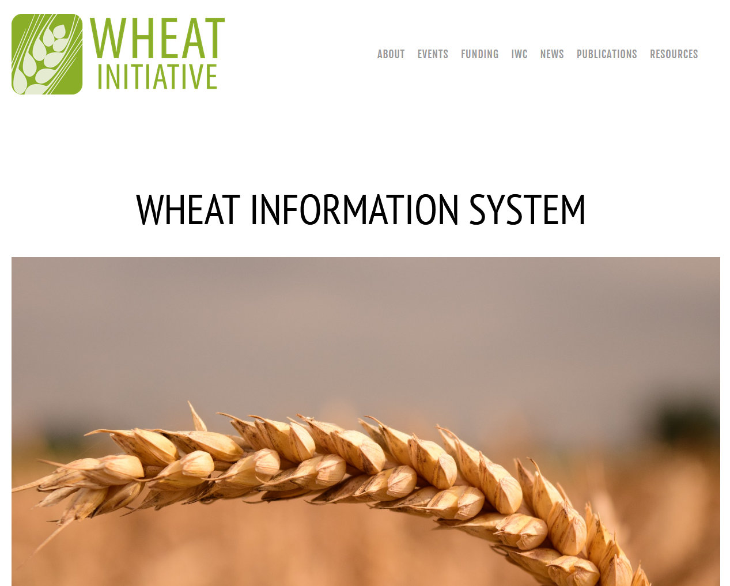
The WheatIS project
Created in 2011 following endorsement from the G20 Agriculture Ministries, the Wheat Initiative provides a framework to establish strategic research and organisation priorities for wheat research at the international level.
The Wheat Initiative endorsed the WheatIS Expert Working group in 2013.
Leadership team in 2020:
Chair: Taner Sen
Co-Chair: Hadi Quesneville, Mario Caccamo, David Edwards
https://www.wheatinitiative.org
Notes:
1

Slide 4
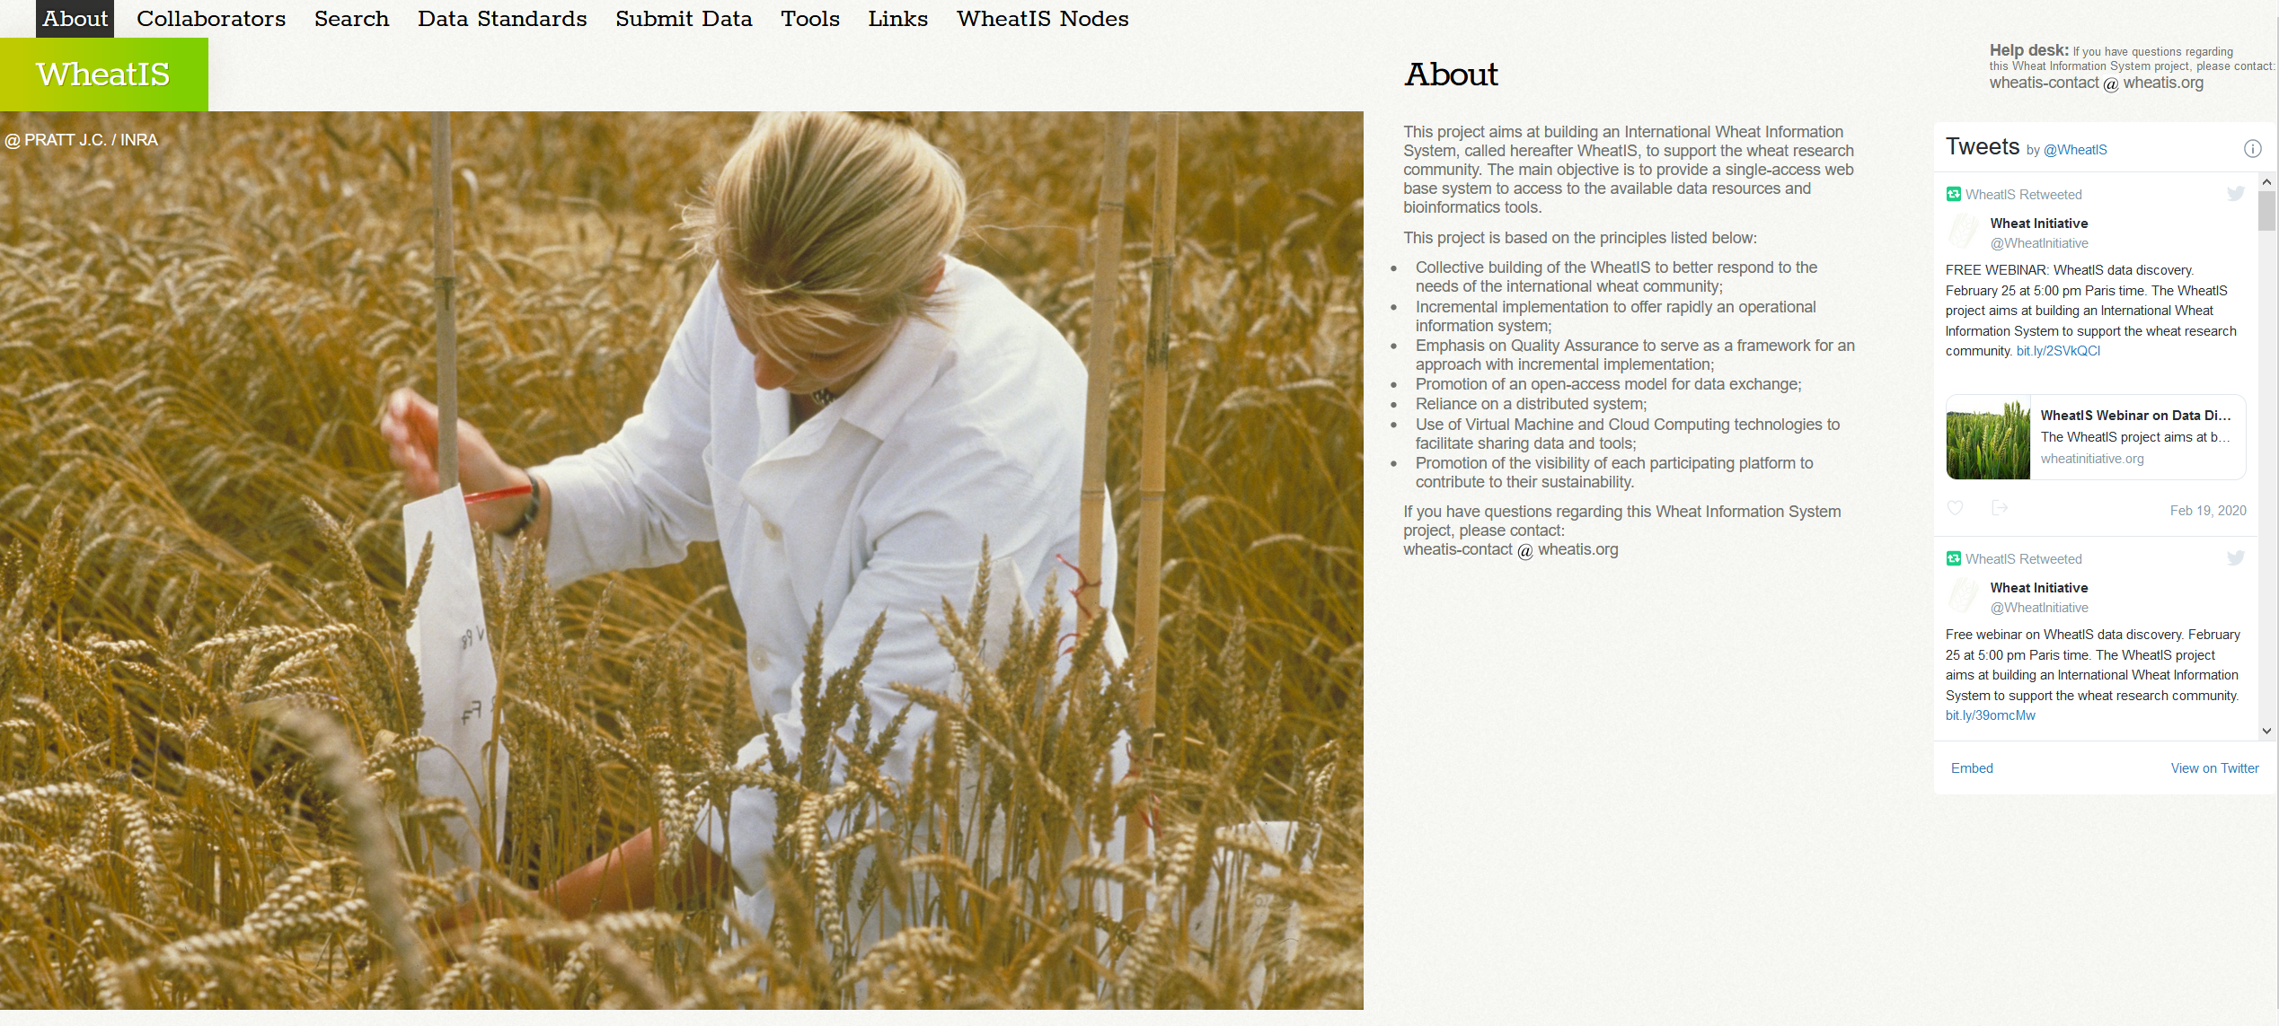
The WheatIS project
The WheatIS project aims at building an International Wheat Information System to support the wheat research community.
The main objective is to provide a single-access web base system to access to the available data resources and bioinformatics tools.
http://www.wheatis.org
Notes:
1

Slide 5
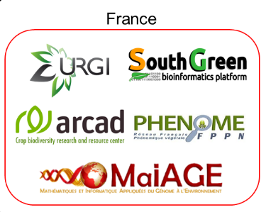
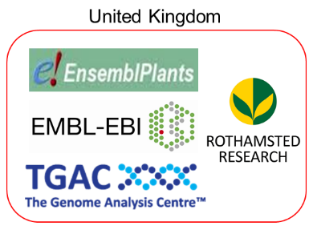
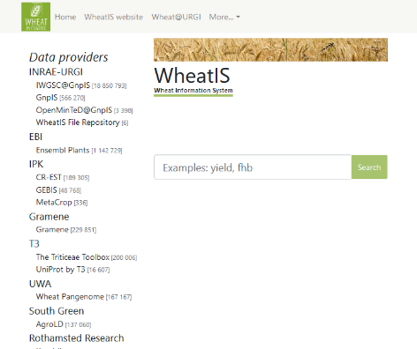
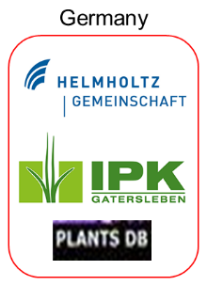
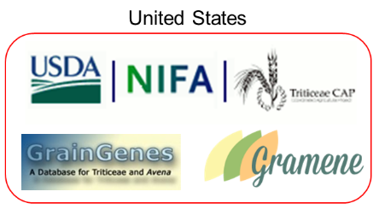
WheatIS DataDiscovery architecture
Normalize
Convert
Store
Bash +
GNU Parallel
Suggestions
Query
Index
Bash + JQ + GNU Parallel
Notes:
1

Slide 6
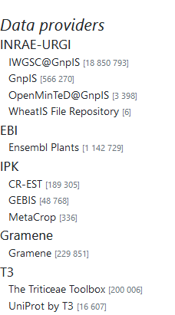
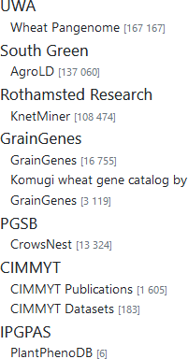
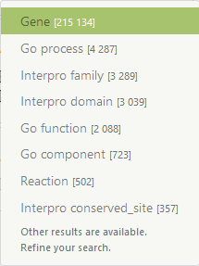
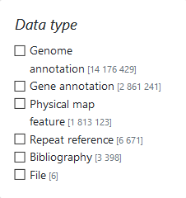
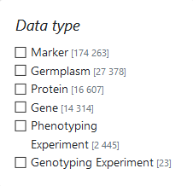
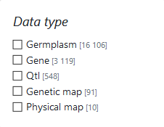
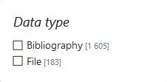
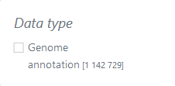
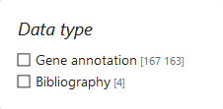
Data providers
Notes:
1

Slide 7
WheatIS data exchange format
Field
Status
Cardinality
Constraints
name
url
description
entryType
species
node
databaseName
mandatory
mandatory
mandatory
mandatory
mandatory
mandatory
mandatory
1
1
1
1
1-*
1
1
unique
none
none
cf. list in doc, recom.
cf. Species list below
same for all a dataset
none
WheatIS species list: Aegilops*, Hordeum*, Triticum*, Wheat*
Format: JSON or TSV, as you wish!
Web server: HTTP of FTP, as you wish!
Solr node only supported for historical partners (deprecated!)
The up-to-date format is always available at https://urgi.versailles.inra.fr/wheatis/join
Notes:
The name (name) allowing to identify easily the referenced resource, ie. TraesCS6D02G140700
A dereferencable URL (url) back-linking to a partner’s online information system
A description (description) containing all the keywords allowing to find the resource
The data type (entryType) of the resource, preferably reusing the existing type
The taxon (species) which the resource is taken from
The name of the data provider (node)
The online database or information system (databaseName) from which the resource comes from
An optional undocumented unique identifier (identifier) among the resources of a given dataset
1

Slide 8
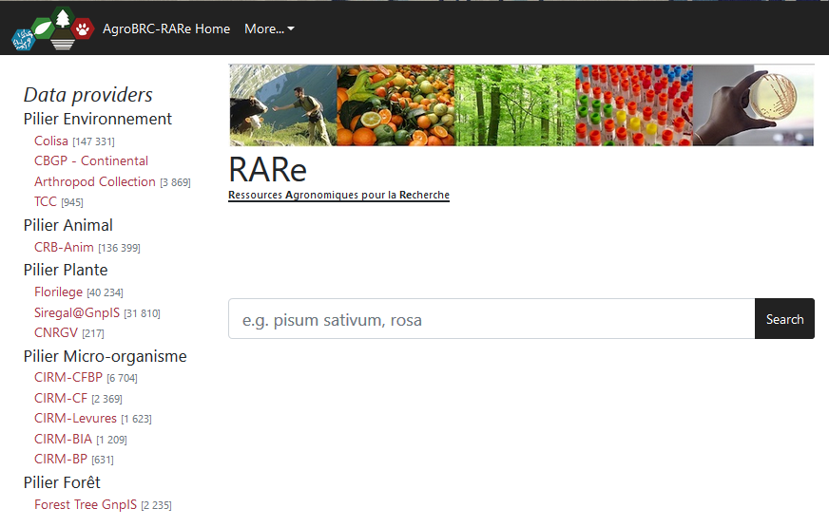
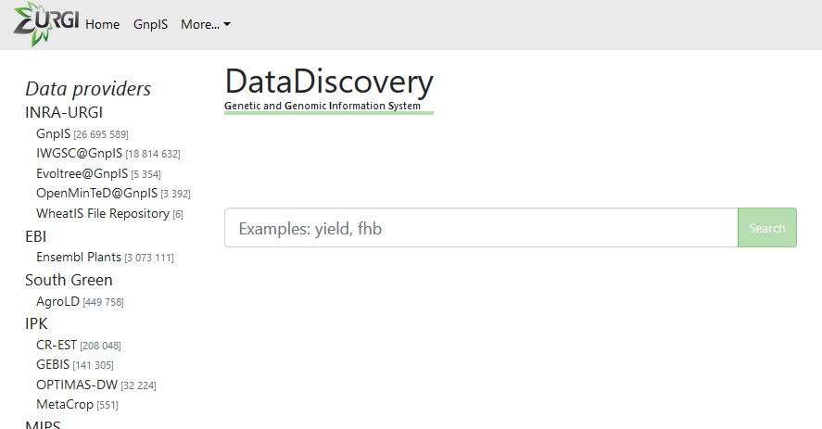
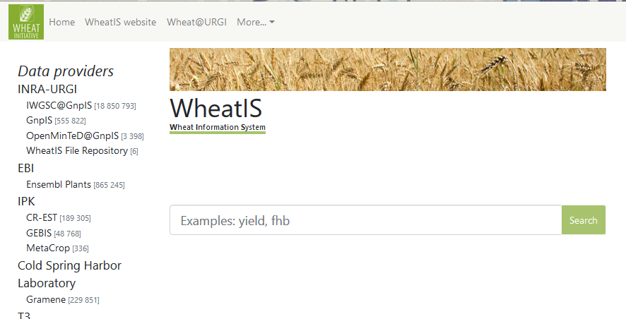
Different flavors
https://urgi.versailles.inra.fr/data-discovery
https://urgi.versailles.inra.fr/rare
https://urgi.versailles.inra.fr/wheatis

Slide 9
WheatIS DataDiscovery web interface
Demo time!
https://urgi.versailles.inra.fr/wheatis/
Notes:
1

Slide 10
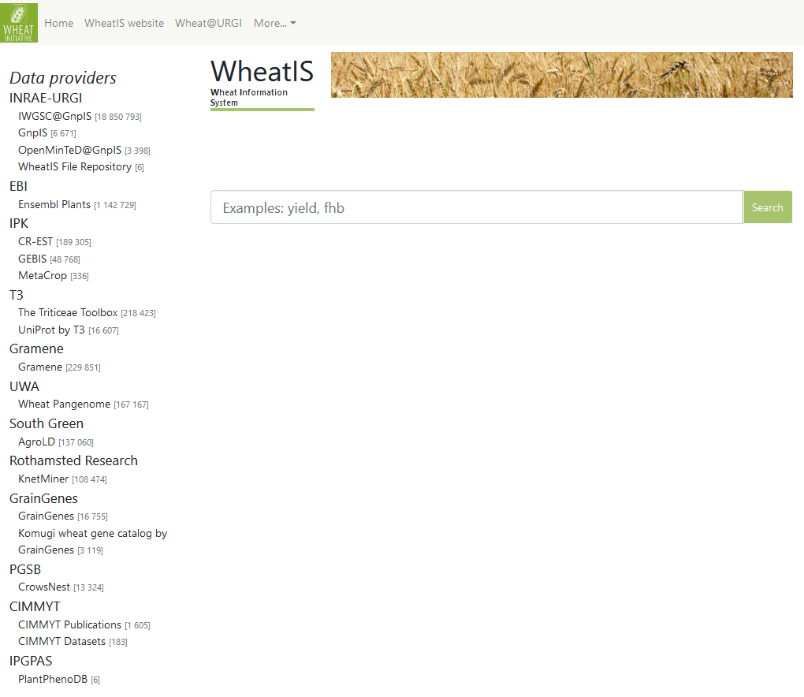
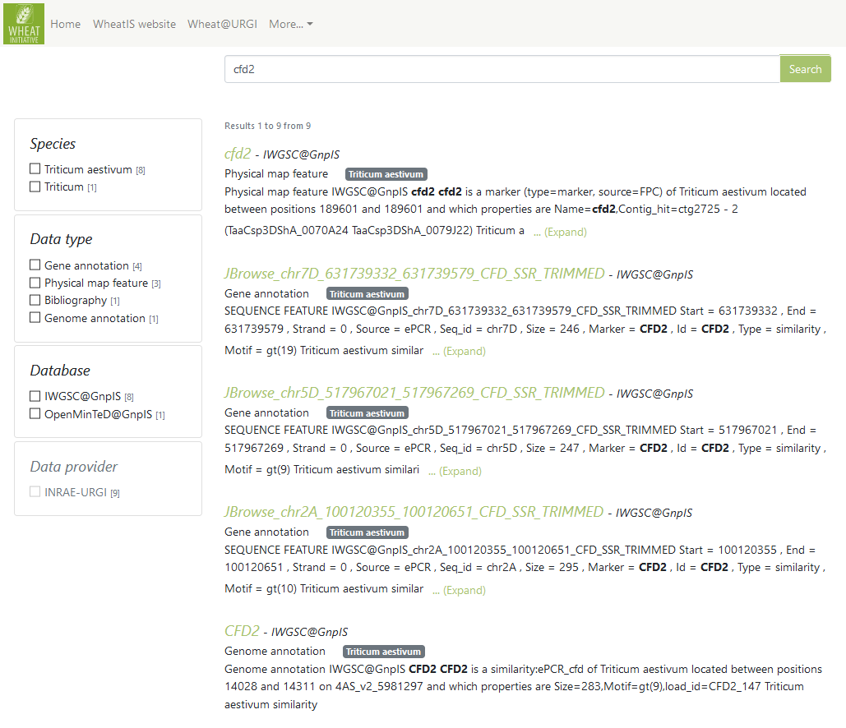
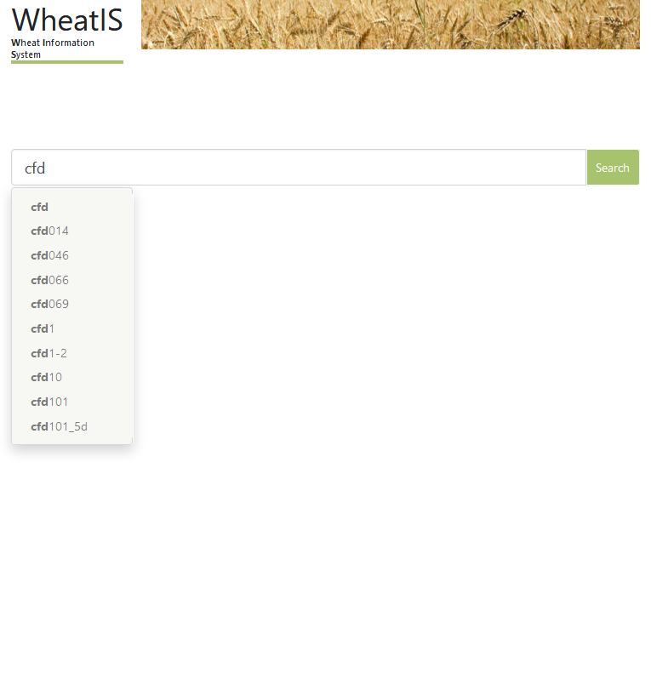
CFD2
Notes:
1

Slide 11
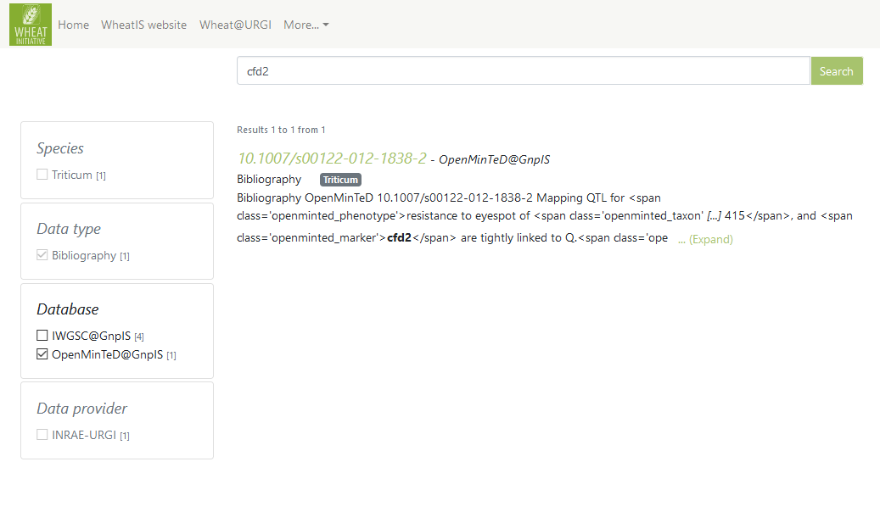
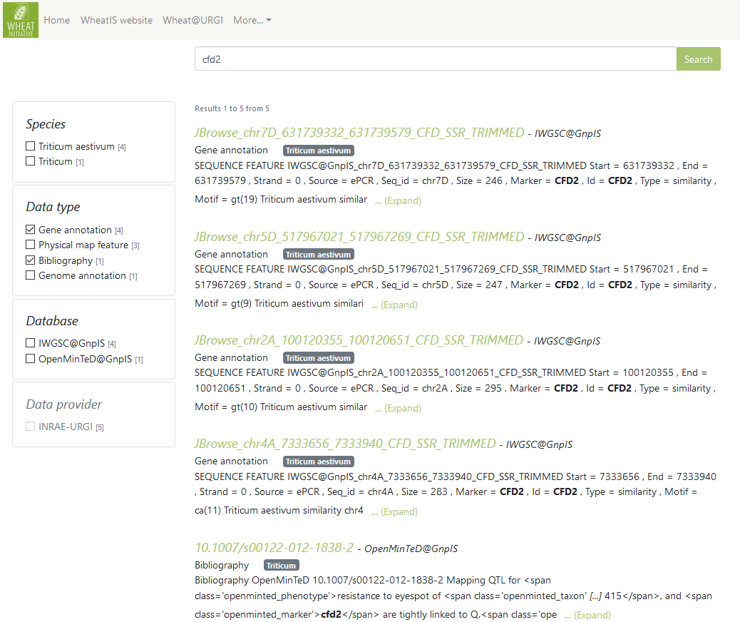
CFD2
Union
(OR query)
Intersection
(AND query)
Notes:
Union filters (inside same category) vs Intersection filters (between 2 different categories)
A single valued category appears grey
1

Slide 12
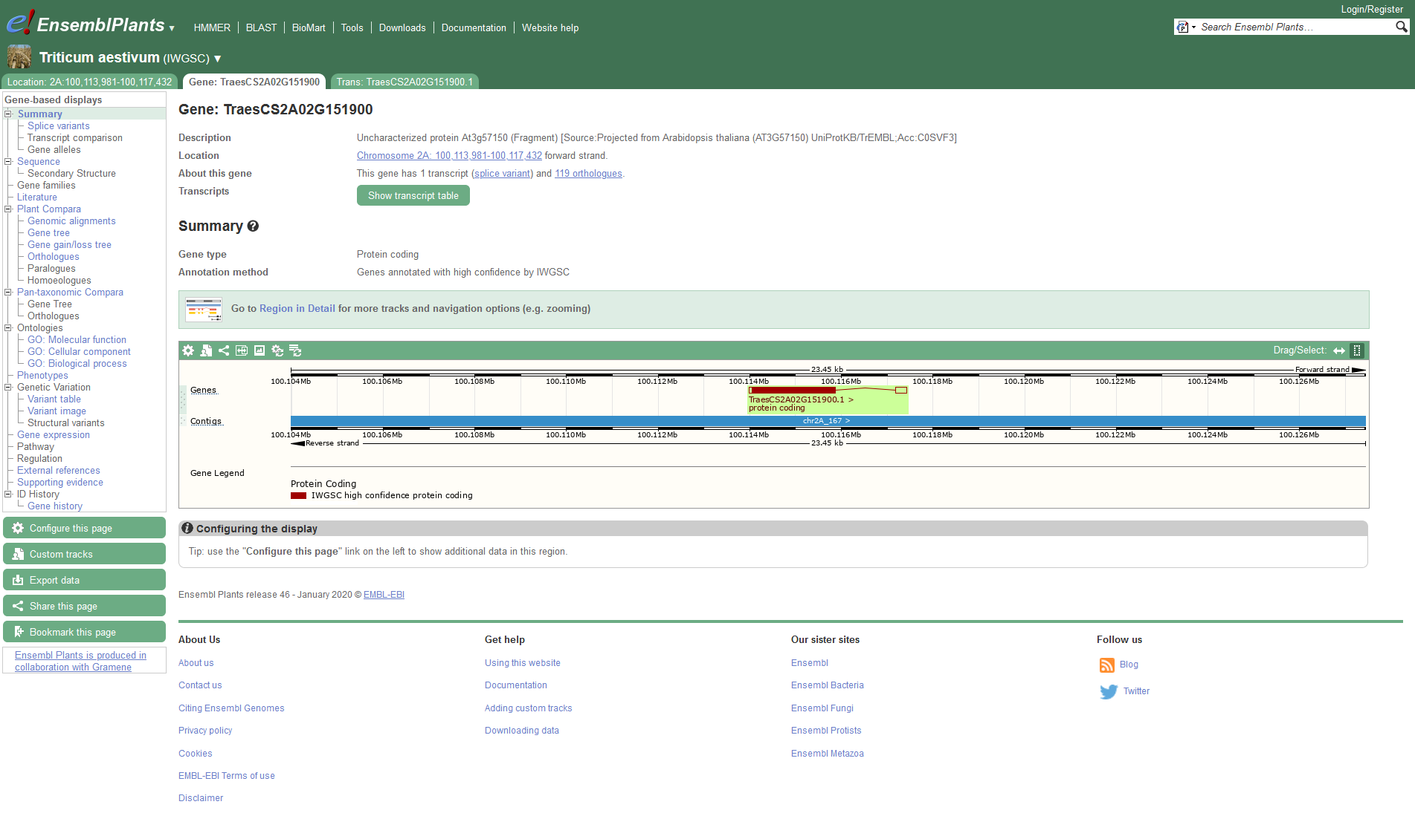
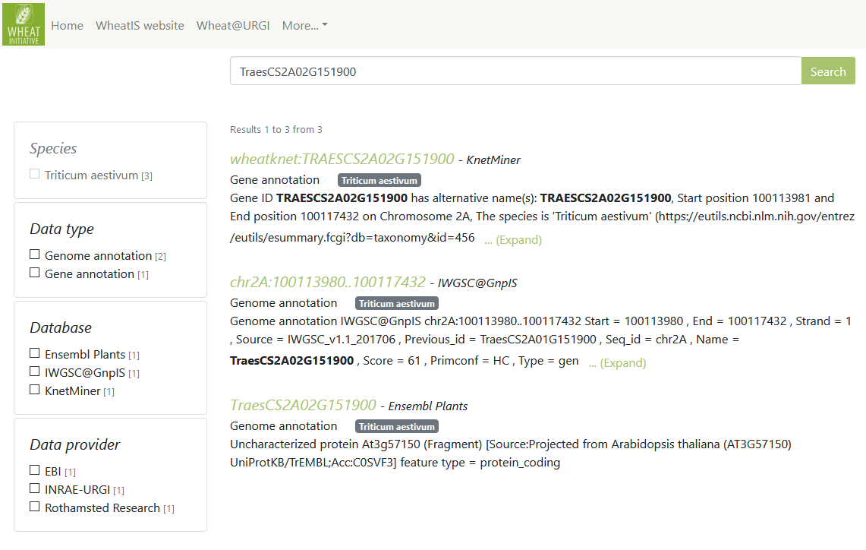
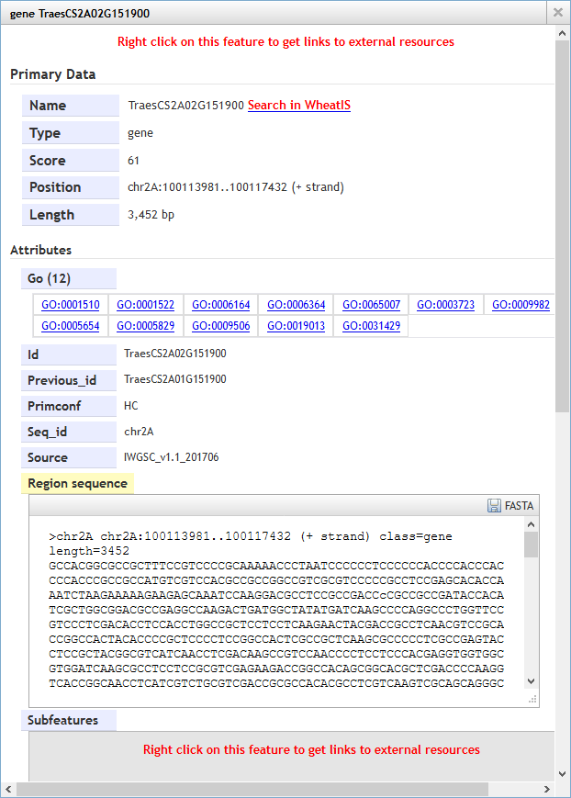
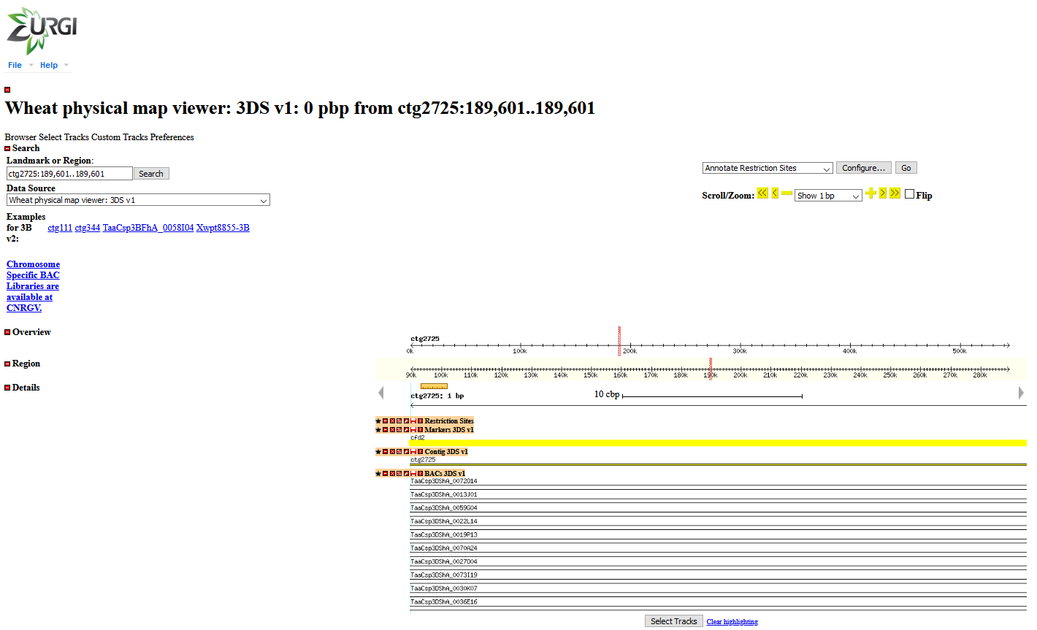
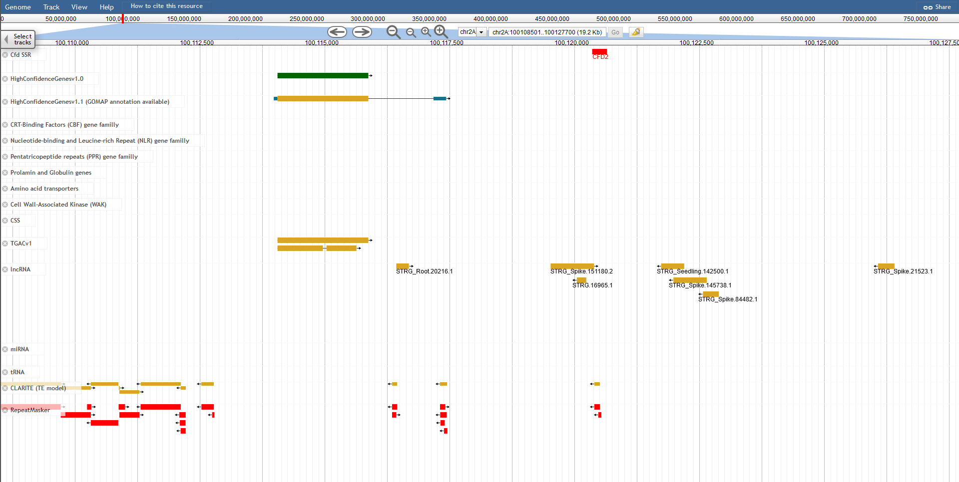
CFD2

Slide 13
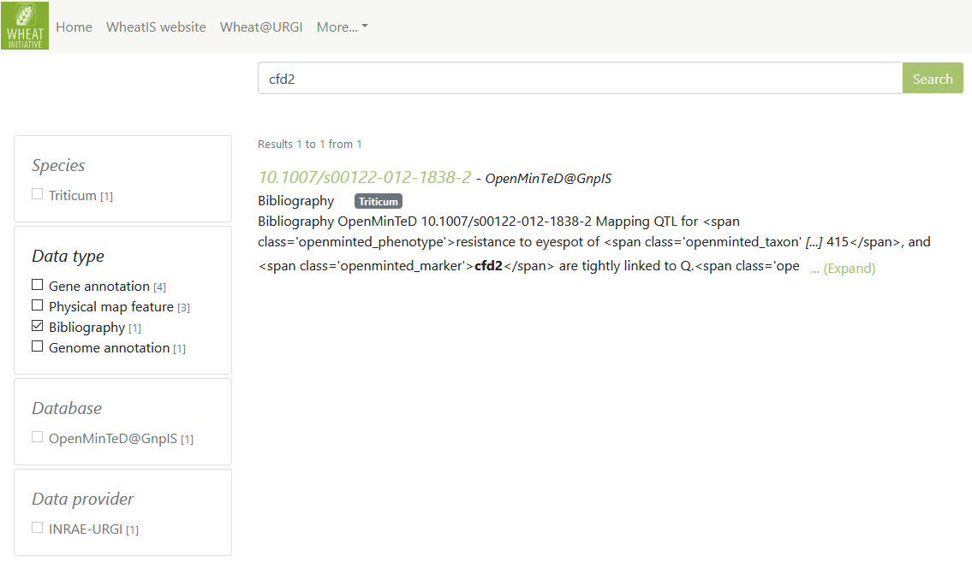
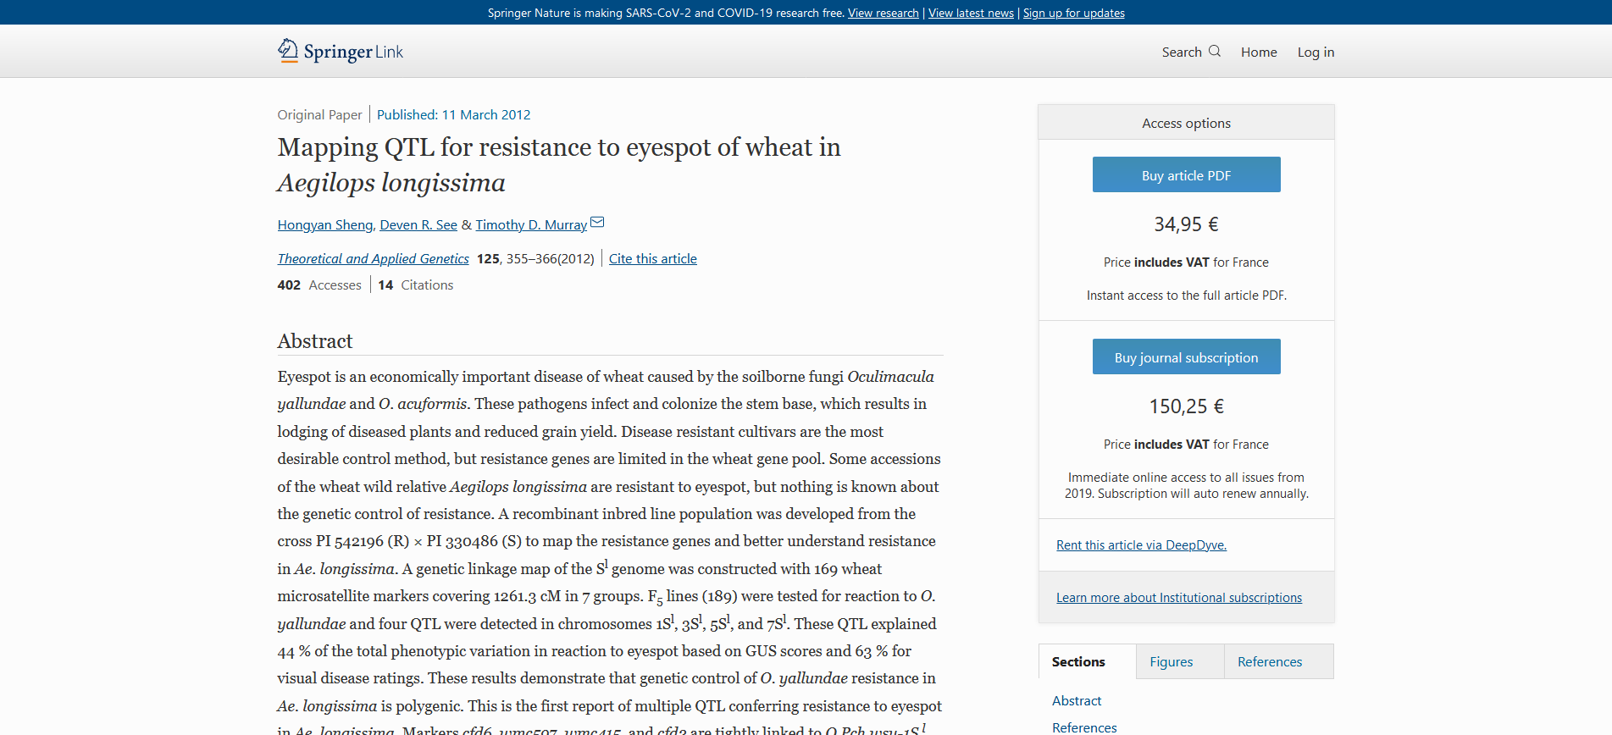
CFD2

Slide 14
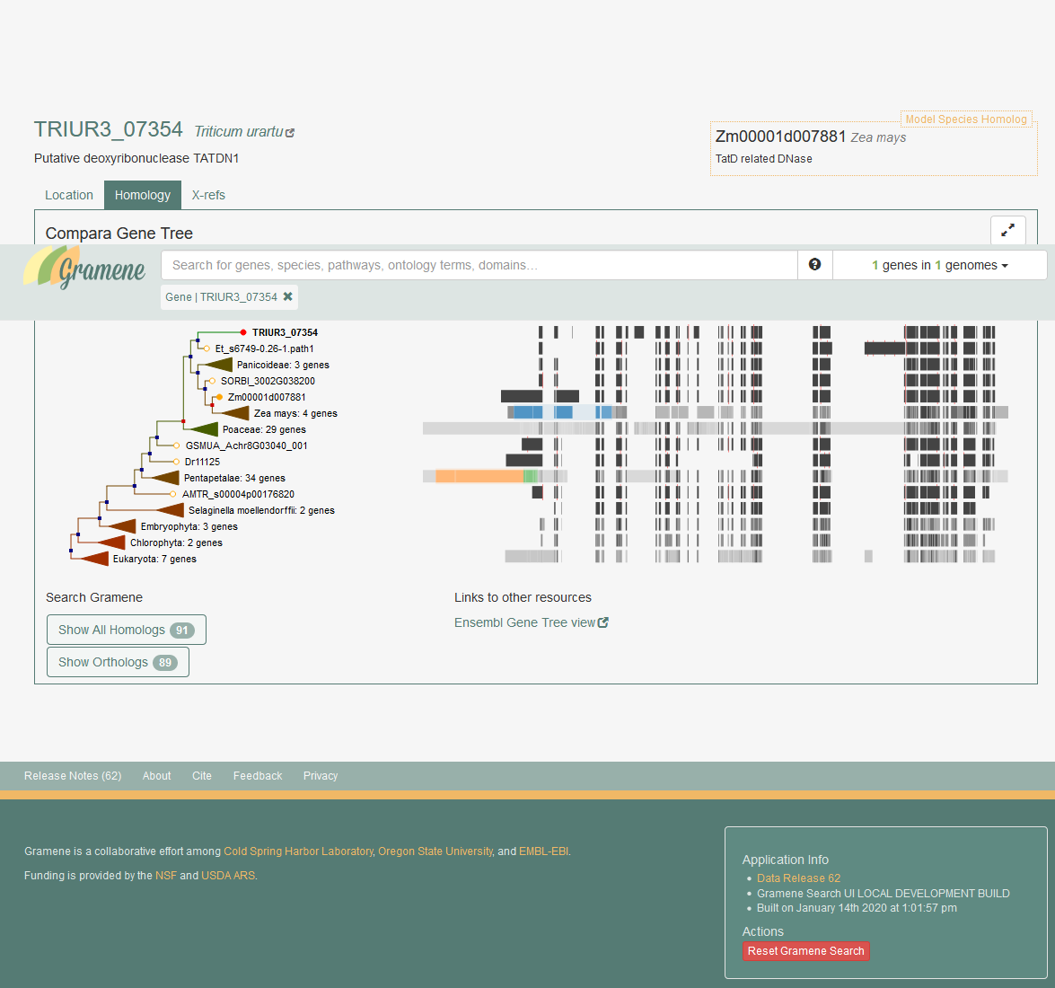
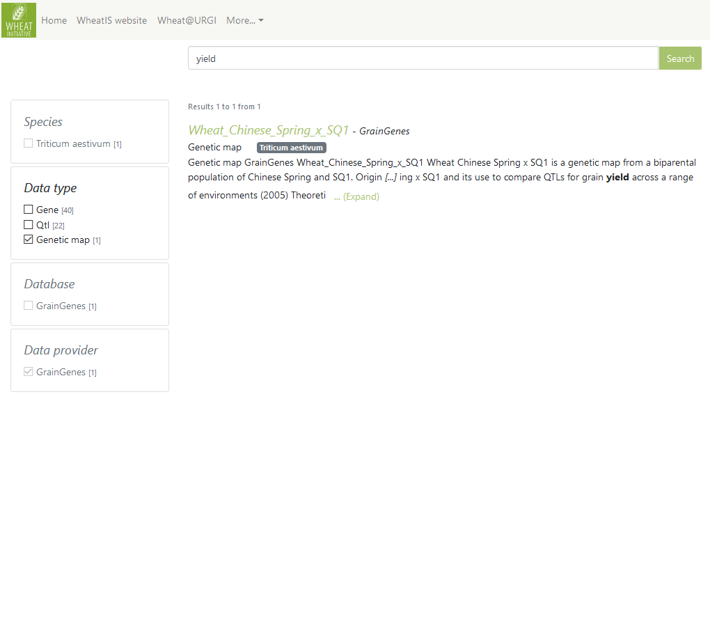
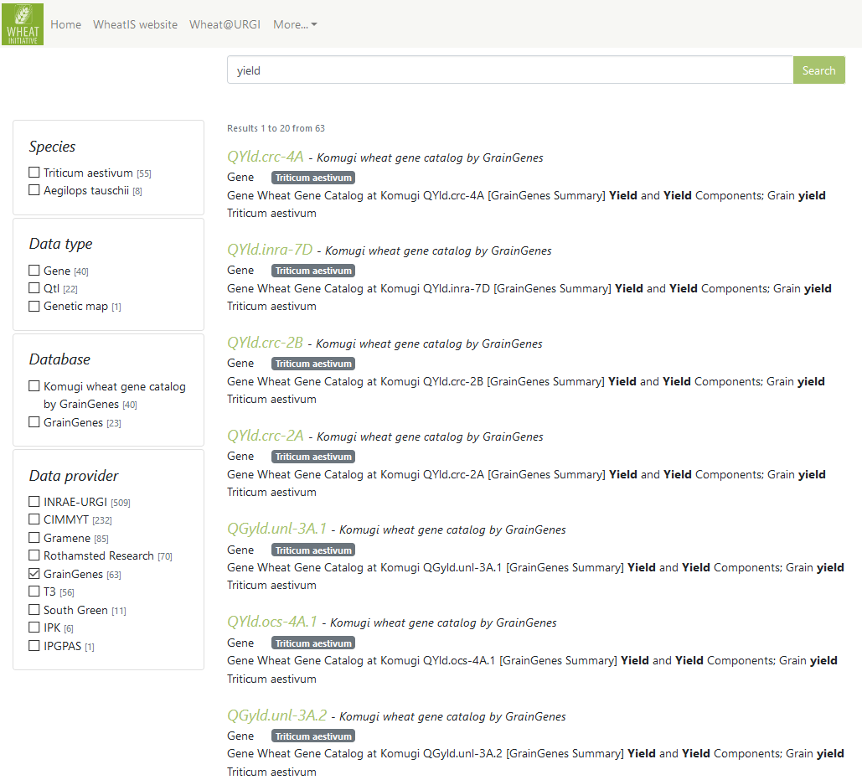
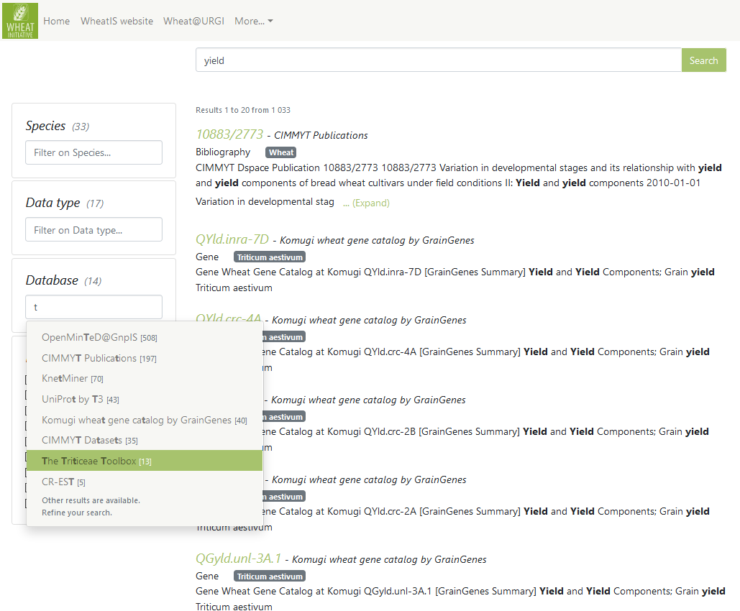
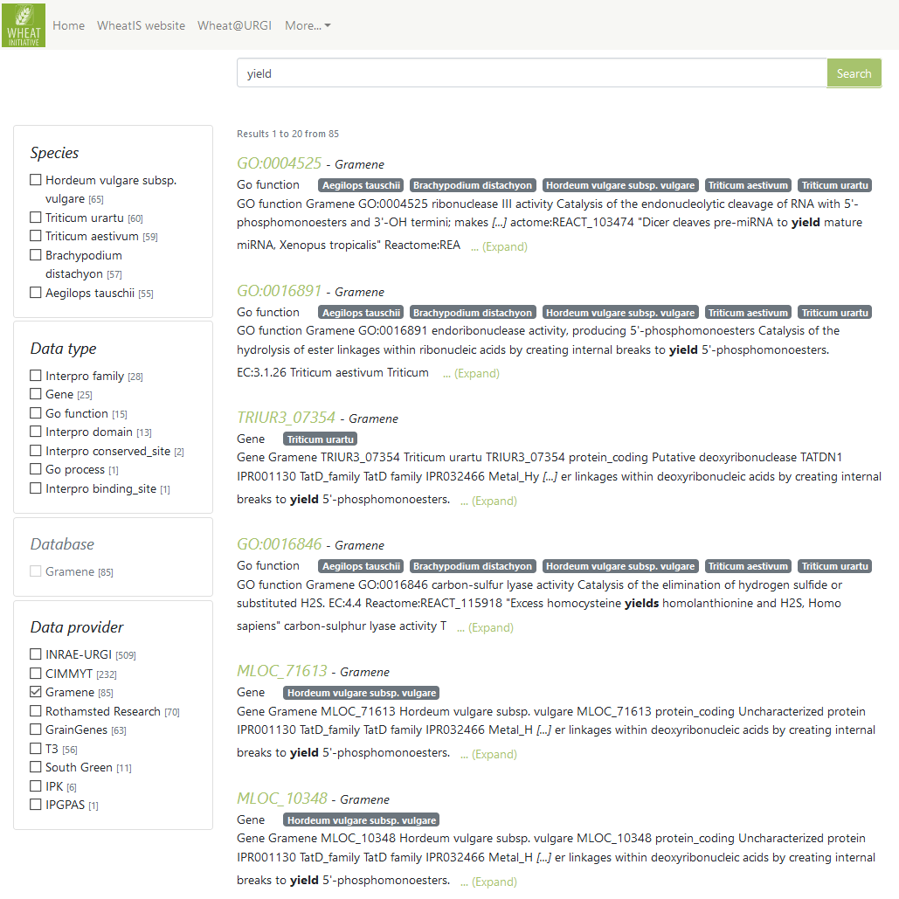
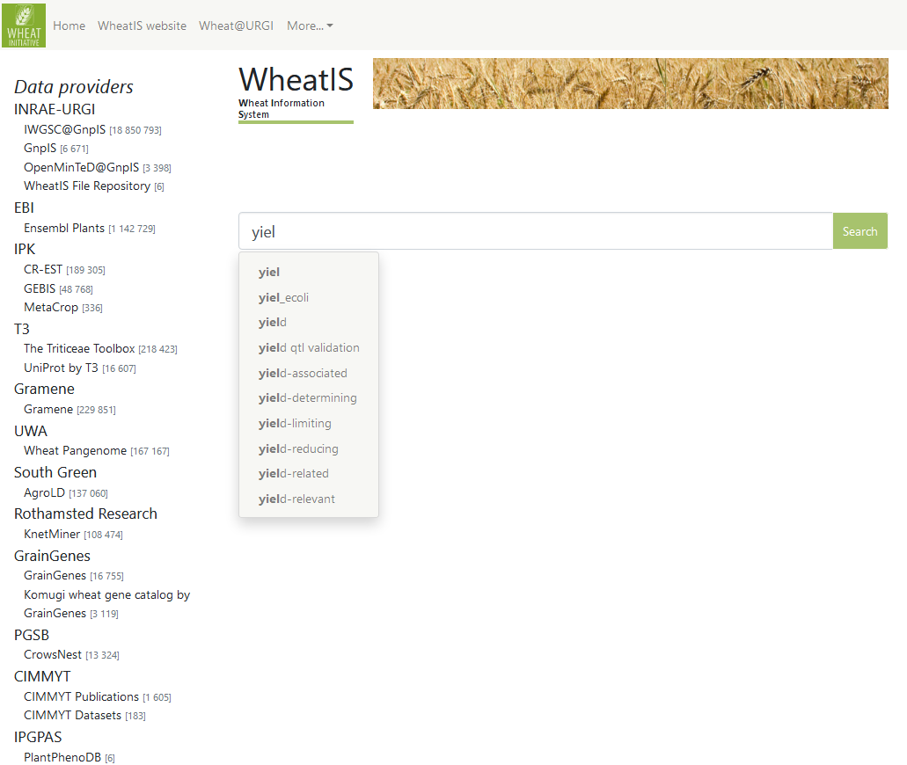
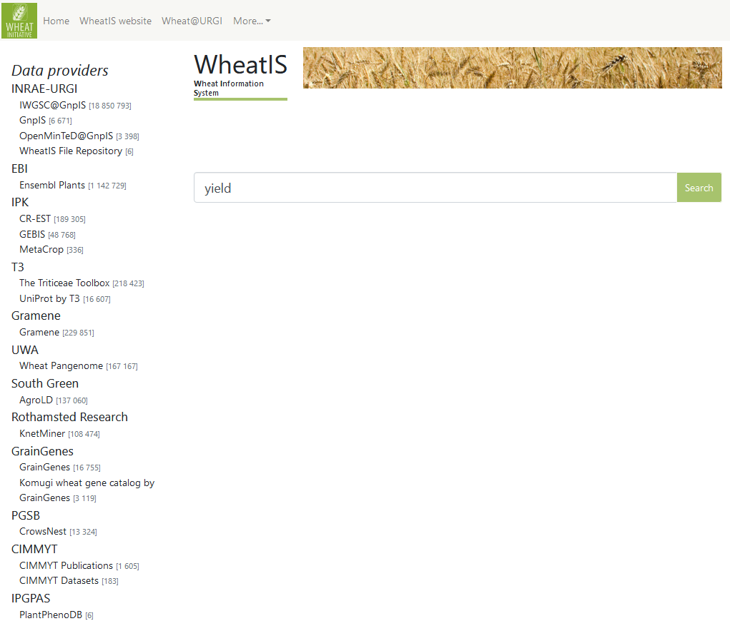
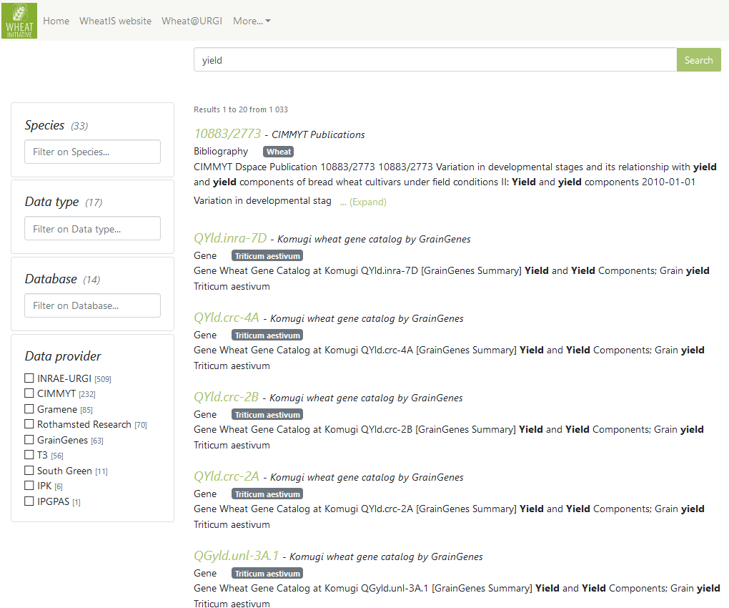
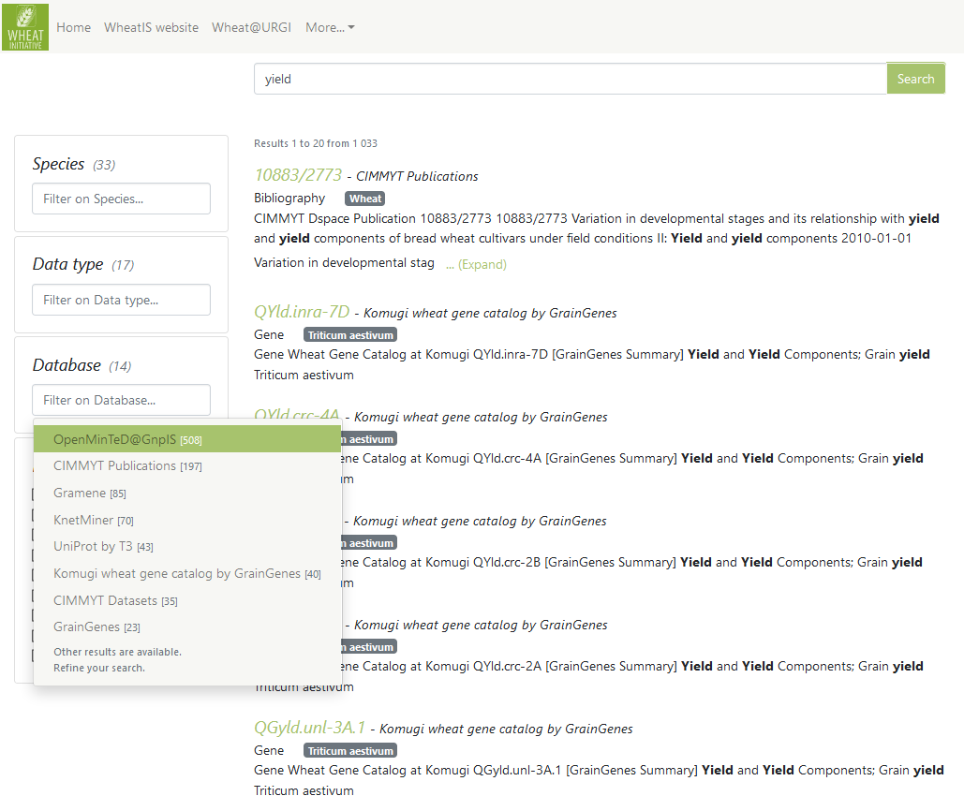
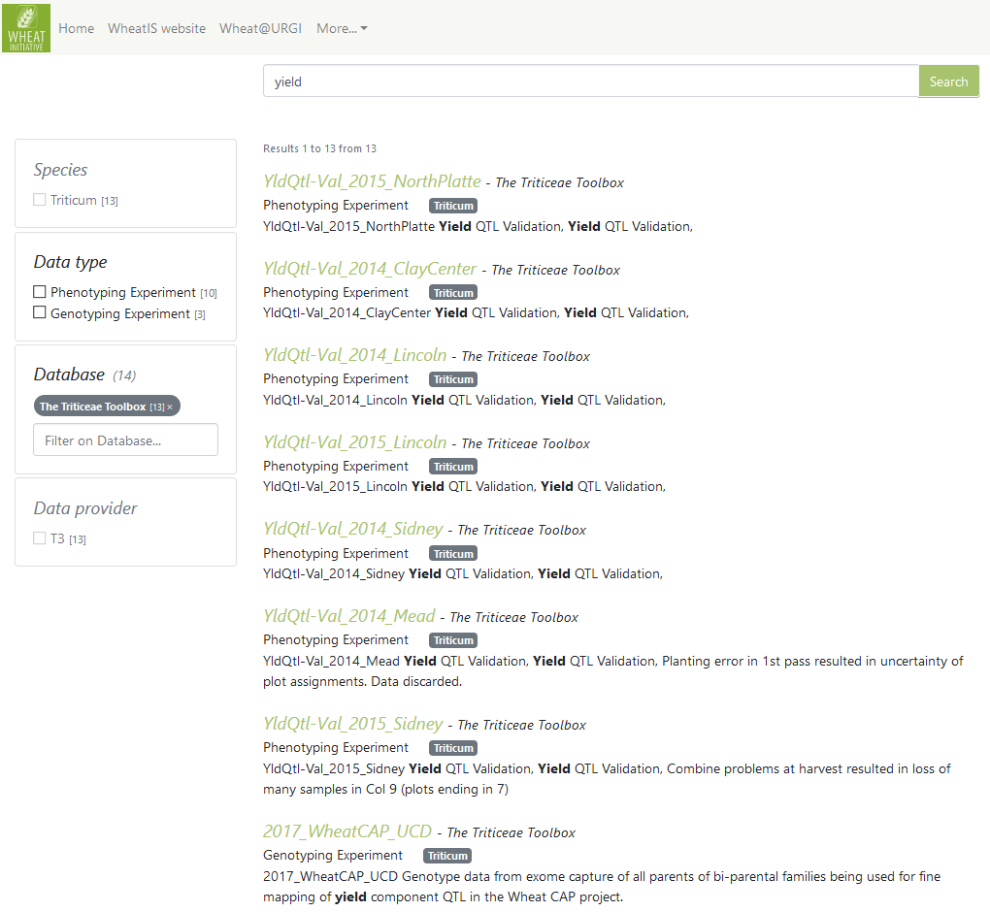
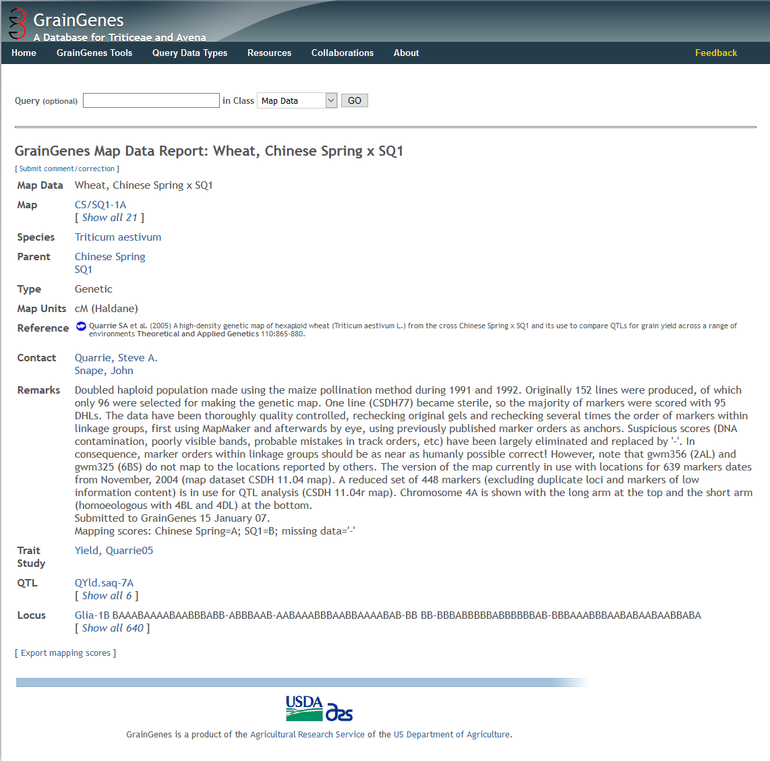
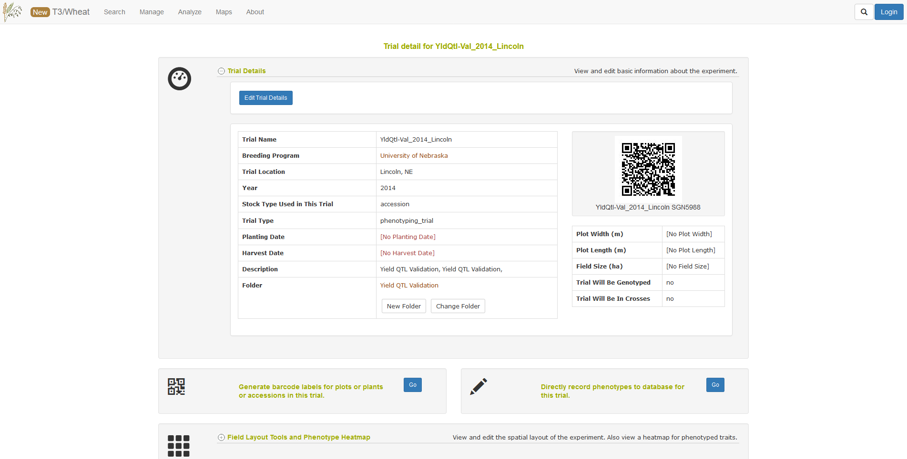
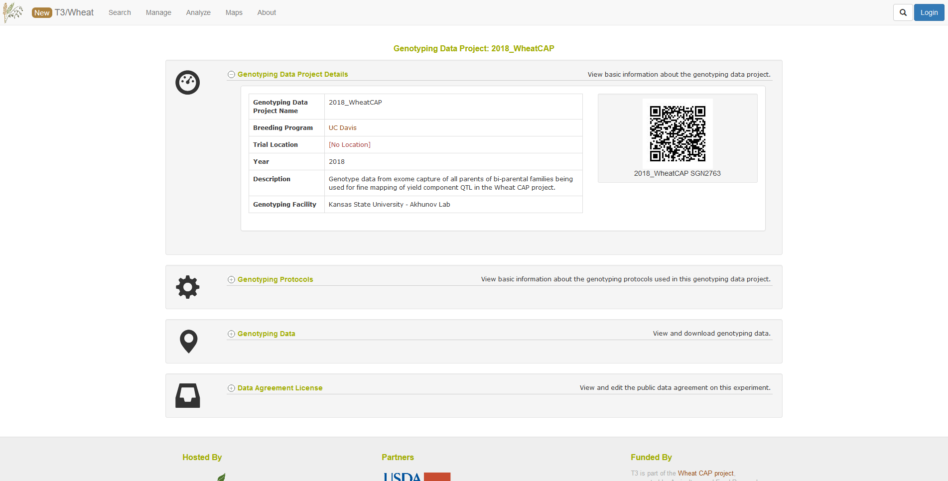
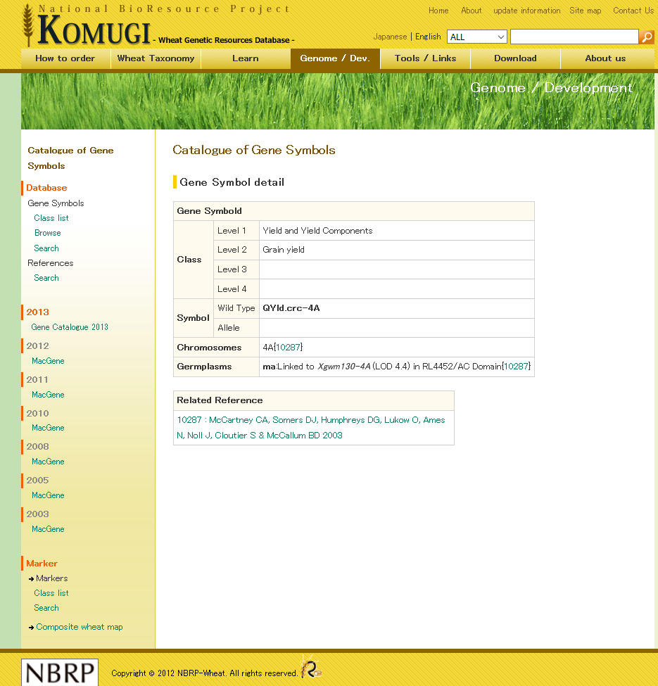
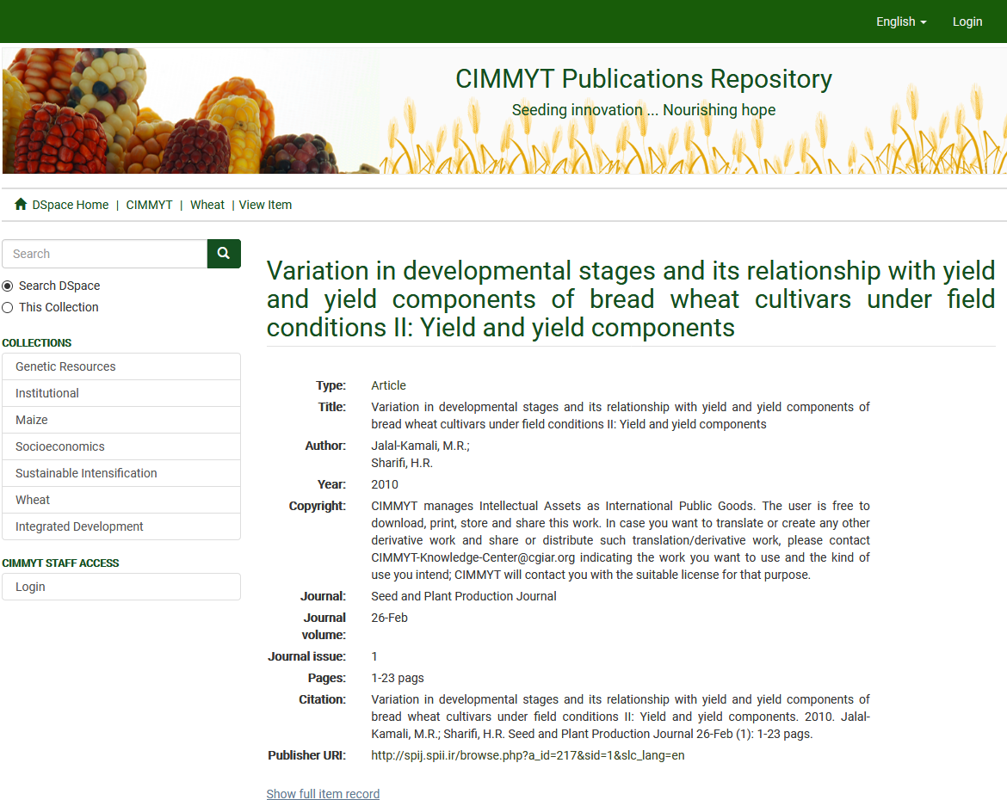
Yield
Notes:
QTL / Trait name : yield https://urgi.versailles.inra.fr/wheatis/search?query=yield
Restrict on Gramene : click on 3rd result: TRIUR3_07354
Restrict on T3 : link on Phenotype & Experiment
Restrict on GrainGenes : Link on KOMUGI gene
Restrict on CIMMYT: link to publication
Restrict on INRAE + Experiment : link to Ephesis <= shows multi restrictions !
1

Slide 15
URL dereferencing
All search parameters and filters are available in the URL for later direct reference, ie.:
https://urgi.versailles.inra.fr/wheatis/search?query=yield&node=Gramene&entry=Gene&species=Triticum%20urartu

Slide 16
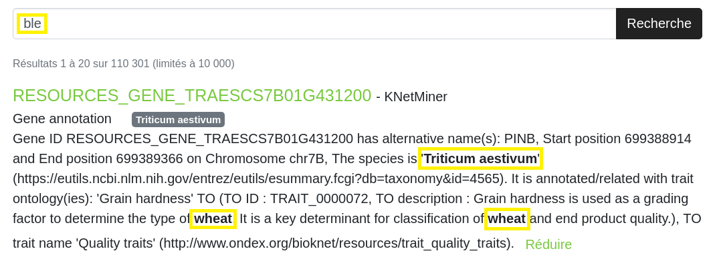
New feature: synonym enrichment
Taxonomy
Taxon synonyms

Slide 17
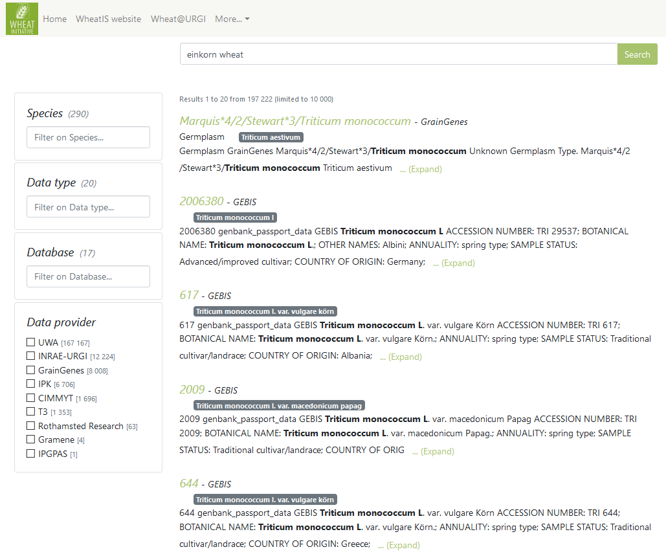
New feature: synonym enrichment

Slide 18
Perspectives
Features:
Data automatic updates, on a regular basis
Move data files away from Git repository
Improve performances (hardware infrastructure)
Some cosmetic improvements
Ontology enrichment (i.e. Gene Ontology)
Data:
New GrainGenes data: 70 map data and 3500 QTLs to come next weeks
IWGSC RefSeq WheatMine
What about your data?

Slide 19
How to contribute
Code
Open source under BSD3 License
Available on our Gitlab instance https://forgemia.inra.fr/urgi-is/data-discovery
Have a look at the readme to install and run locally
Contributions are very welcome! Follow the guidelines
Data
Documentation on How to join the WheatIS federation https://urgi.versailles.inra.fr/wheatis/join
We offer support, contact us at urgi-contact@inrae.fr
Notes:
1

Slide 20
Take home message
WheatIS
A federation of wheat data repositories for public data discovery
Simple and generic data model
Open source state-of-the-art web interfaces
Easy to join: provide TSV or JSON files and ping us!

Slide 21
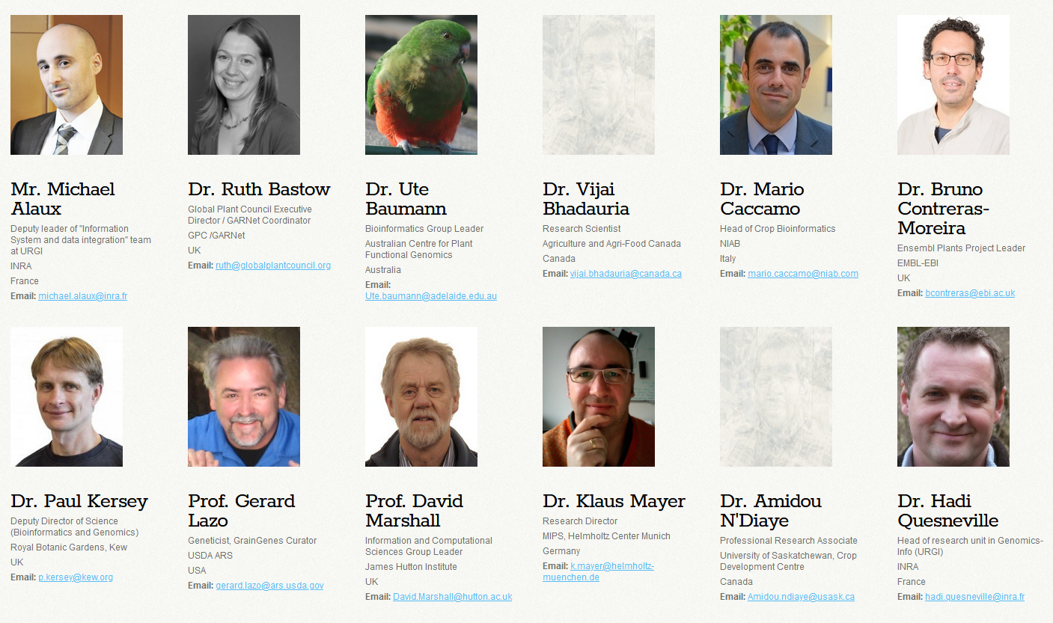
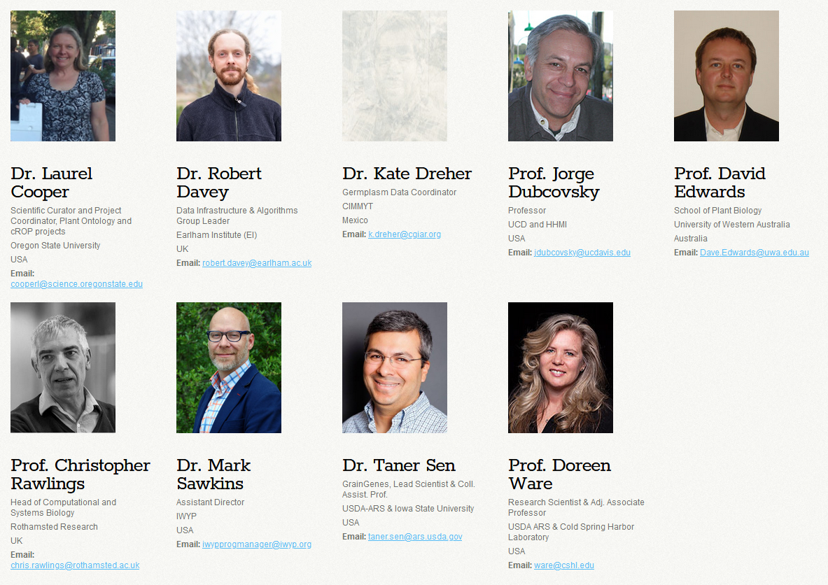
Acknowledgements
Data providers:
Kate Dreher (CIMMYT)
Jesus Herrera de la Cruz (CIMMYT)
Dave Edwards (UWA)
Philipp Bayer (UWA)
Clayton L. Birkett (T3)
Marc Chakiachvili (EBI)
Bruno Contreras Moreira (EBI)
Dan Bolser (EBI)
Paul Kersey (EBI)
Victoria Blake (GrainGenes)
Margaret Woodhouse (GrainGenes)
Steve Michel (GrainGenes)
Uwe Scholz (IPK)
Matthias Lange (IPK)
Daniel Arend (IPK)
Andrew Olson (Gramene)
Keywan Hassani-Pak (Rothamsted)
Marco Brandizi (Rothamsted)
Manuel Spannagl (PGSB)
Robert Bossy (INRAE) …
The WheatIS EWG
Raphaël Flores
Cyril Pommier
Bilal El-Houdaigui
Célia Michotey
Erik Kimmel
Dorothée Charruaud
Nacer Mohellibi
Nicolas Francillonne
A.F. Adam-Blondon
Hadi Quesneville
Michael Alaux
Whitney Buchanan
(Communication manager)
Publication under writing
Since then, please cite:
@gnuraph
raphael.flores@inrae.fr
@michaelalaux
Alaux et al., Genome Biology 2018
michael.alaux@inrae.fr
https://doi.org/10.1186/s13059-018-1491-4
@WheatIS
wheatis-contact@wheatis.org
Notes:
1

